Slide 1


SC1015 MINI PROJECT:
Stock Market price predictor
A137_Group 2 : Shankar Mathangi (U2223221G) & Koppisetti Sai Sruthi (U2223033D )

Slide 2
Table of contents:
01
02
03
04
INTRODUCTION
lINEAR REGRESSION
LSTM MODEL
STOCK PRICE PREDICTION

Slide 3
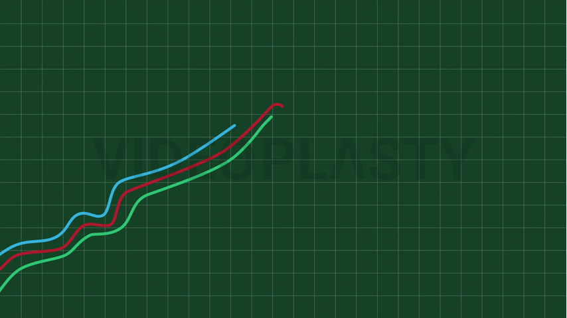

Slide 4
Problem definition
Stock markets have always been hard to predict with certainty

Slide 5
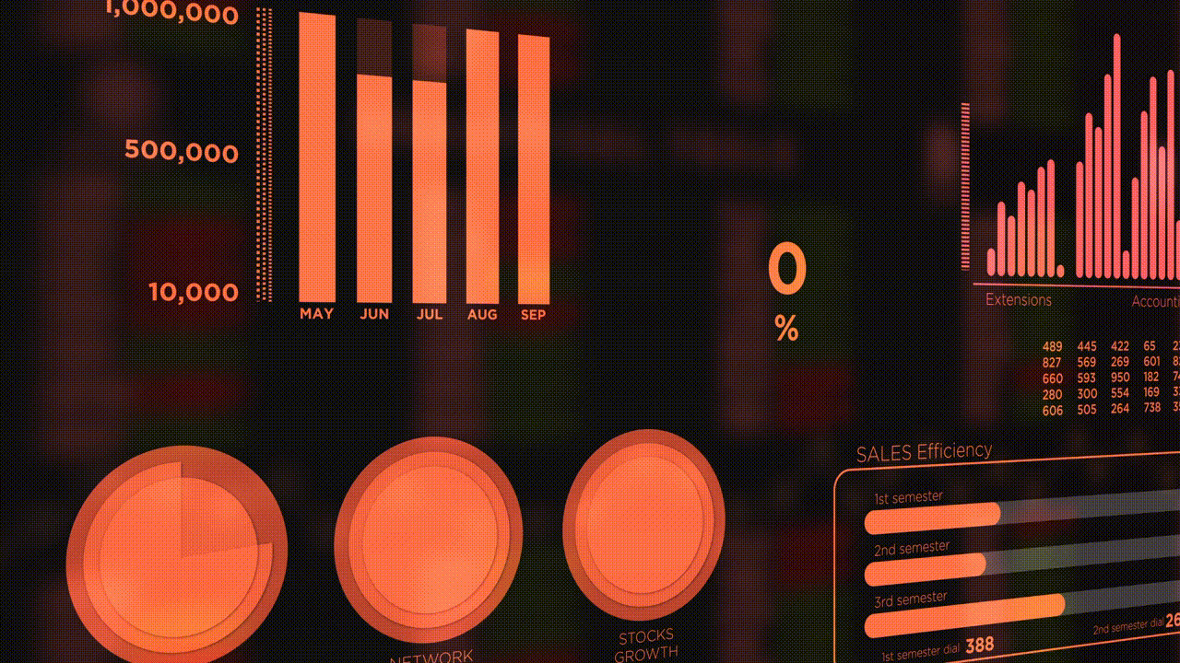
Probabilistic estimate of stock prices using Linear Regression and LSTM

Slide 6

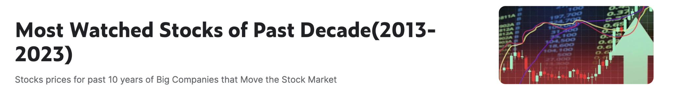

Our dataset

Slide 7
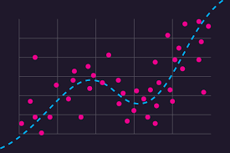
LINEAR REGRESSION
Predicting Stock Prices of APPLE using linear regression

Slide 8


Cleaned the Dataset
Created a subset Dataset

Slide 9
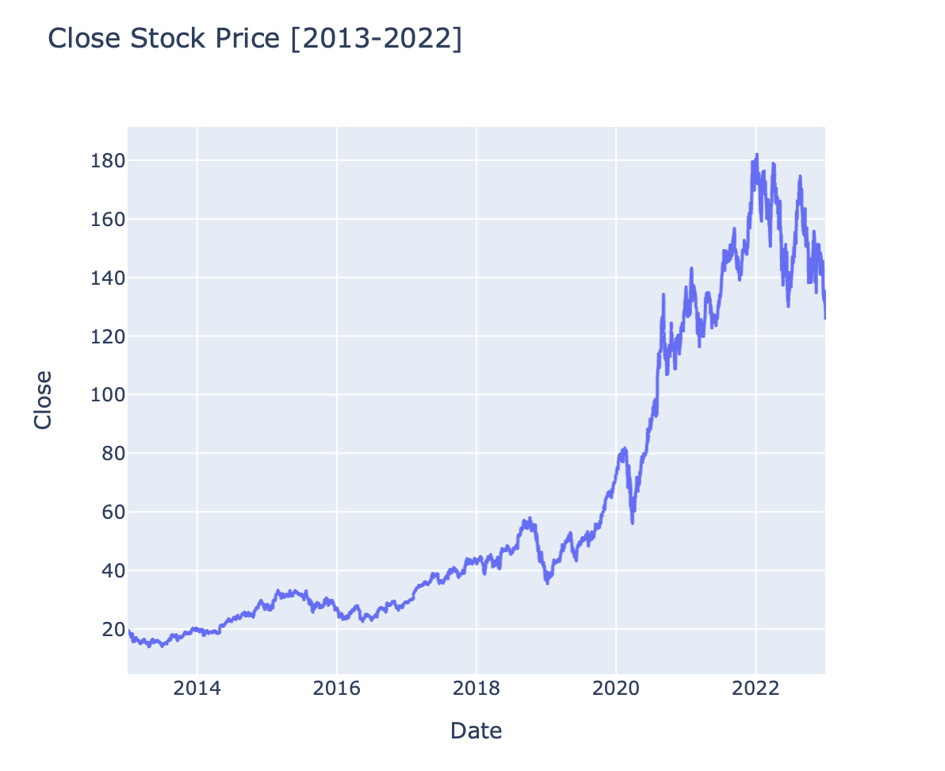
Close stock price (2013-2022)

Slide 10
Splitting the DataSet
Training set
Testing set
80%
20%
x_train
y_train
x_test
y_test

Slide 11
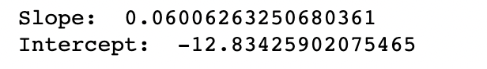
Creating a Fit Linear Model
Evaluated the model
-By interpreting the slope and intercept coefficients.

Slide 12
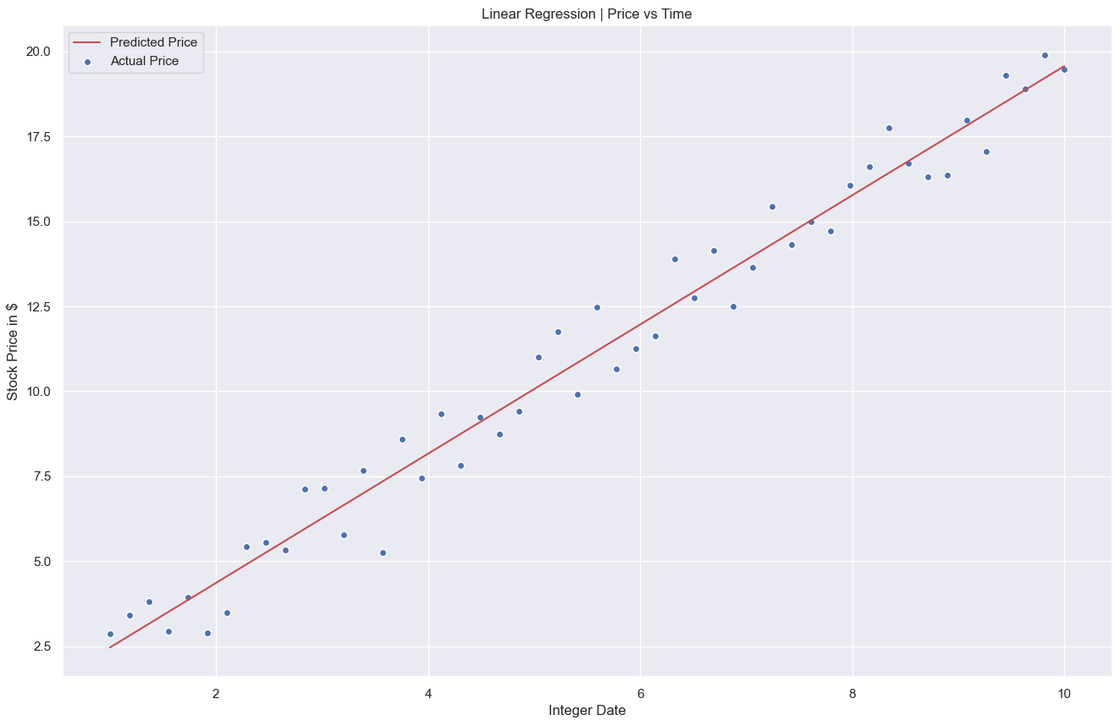
Linear Regression Model’s Performance on the Training Data

Slide 13
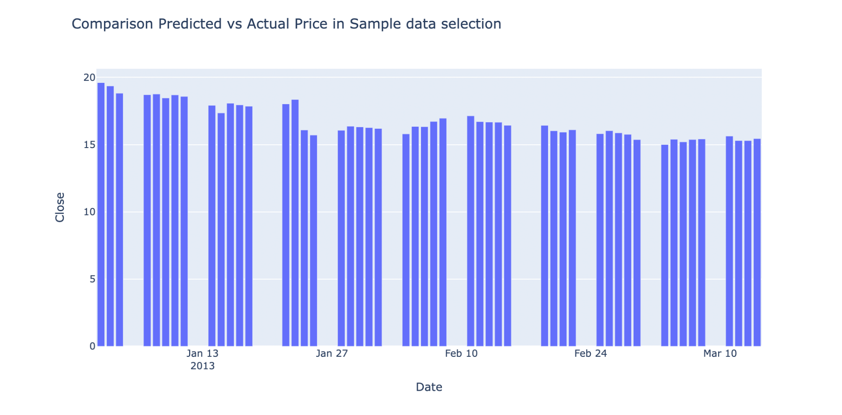
Evaluating Regression by comparing the Predicted values with the actual values on a random sample from data set

Slide 14
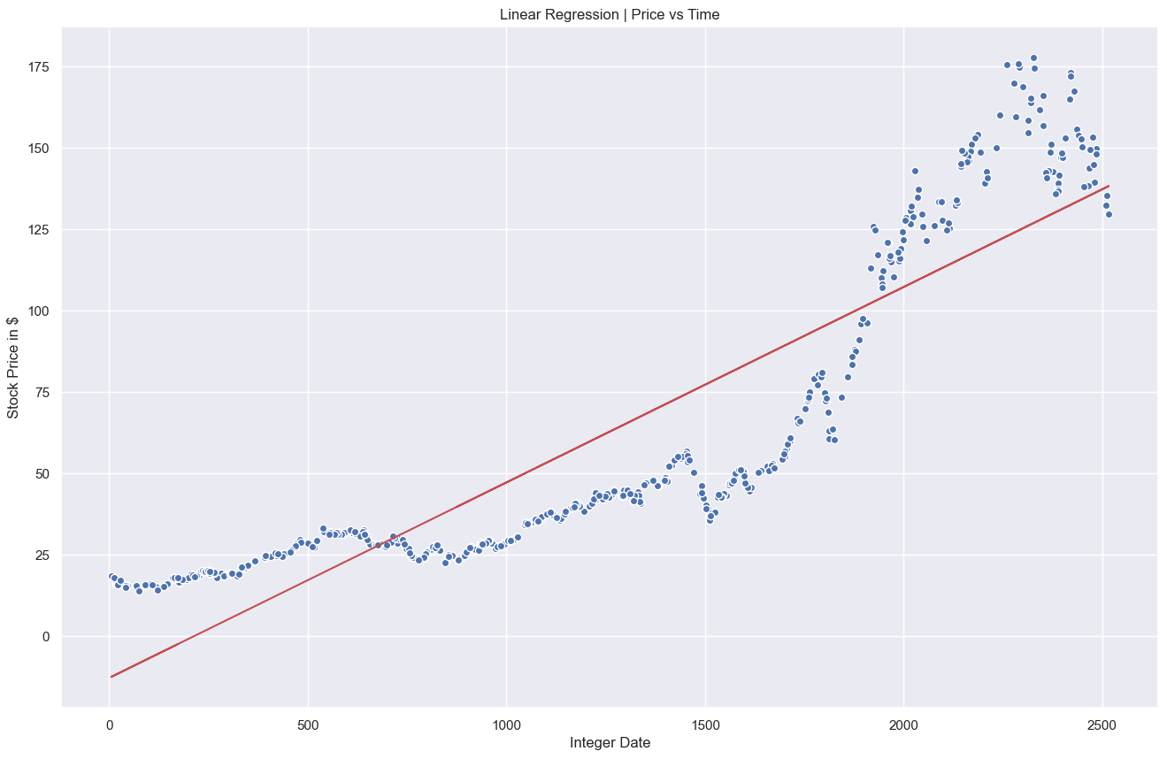
Evaluating the Linear Regression Model on the Test Data

Slide 15
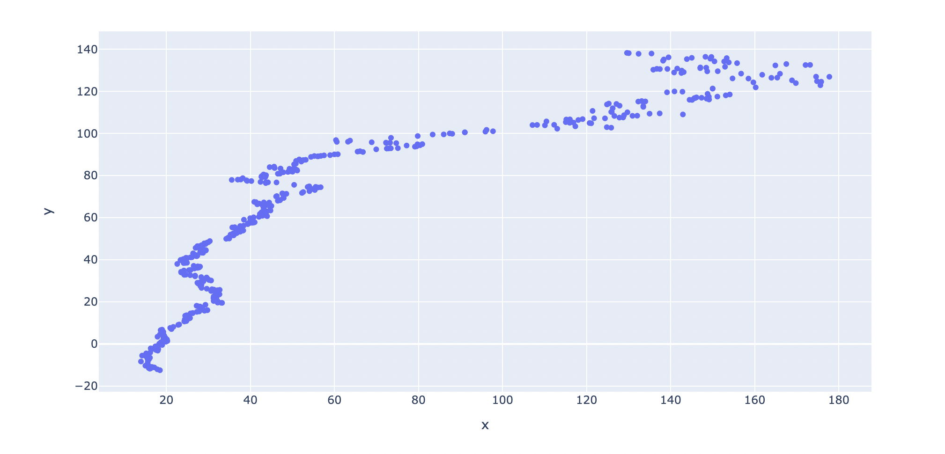
Model’s Predictions vs Actual Prices

Slide 16
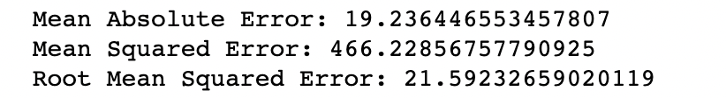
Assessing Performance of the Model
-Mean Absolute Error
-Mean Squared Error
-Root Mean Squared Error

Slide 17
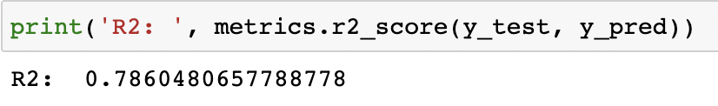
Outcome of linear regression:
R² => Measure of the goodness of fit that tells how well the regression line approximates the actual data.

Slide 18

LSTM:
Long Short-Term Memory model is used to learn order dependence in sequence prediction problems

Slide 19



Slide 20

Separate the stock prices by extracting 80% of the closing prices as our train data
Training set
Test set

Slide 21
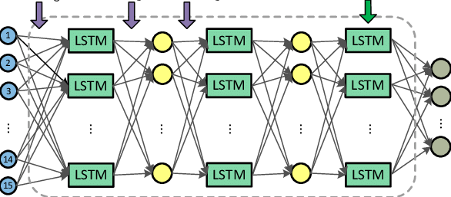
2 LSTM layers + 2 densely connected neural network layers

Slide 22
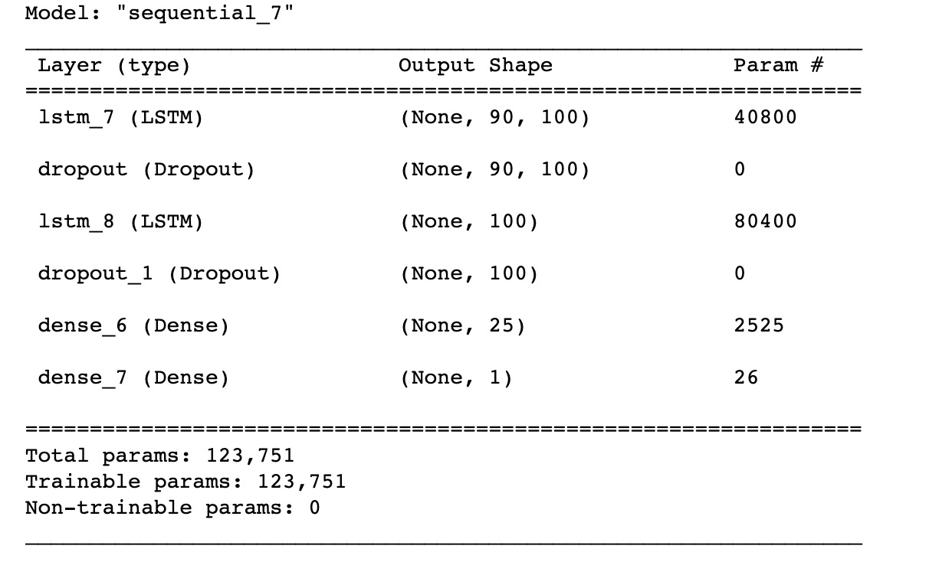
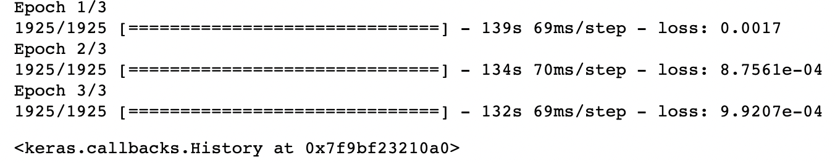
LSTM network architecture summary:

Slide 23
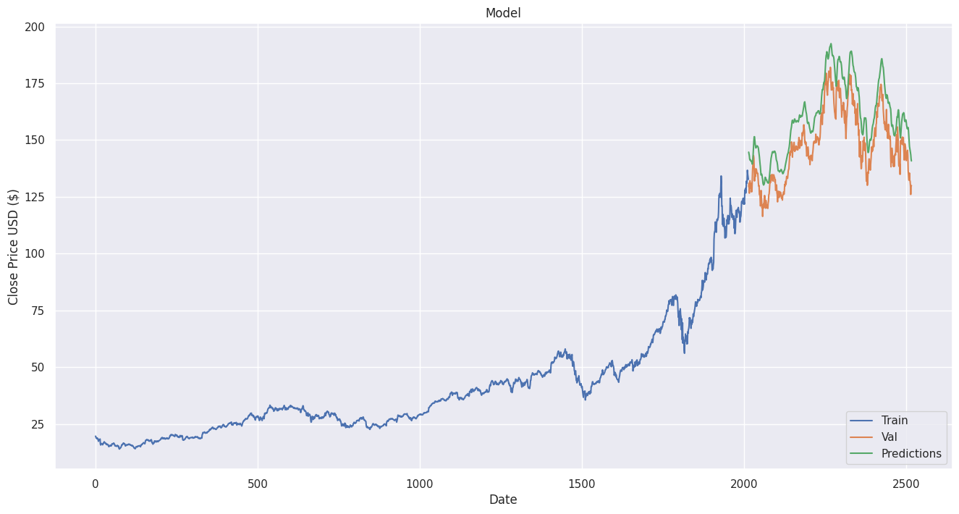
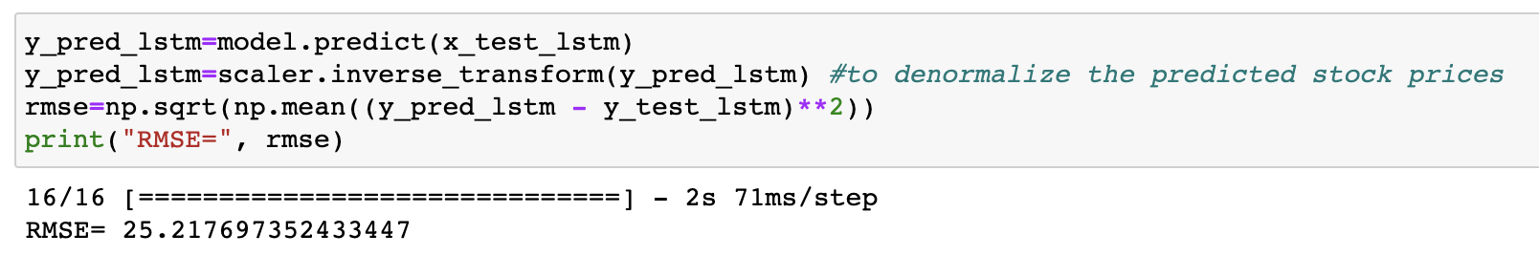
RMSE value helps analyze model performance

Slide 24
Thank you!

Slide 25


